Slide 1


Slide 2
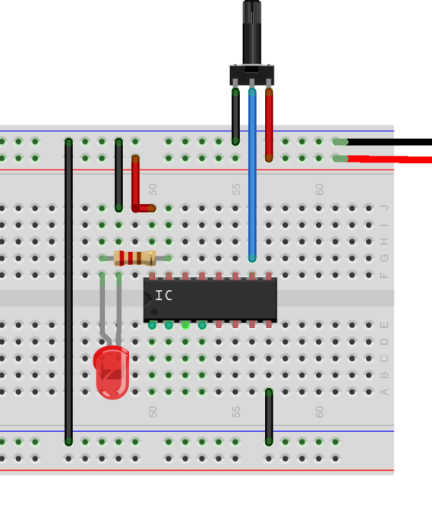
Why Connect?

Slide 3
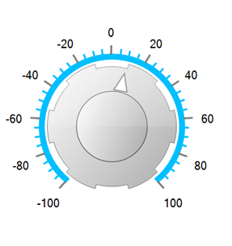
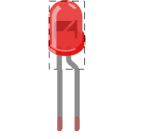

Remote (and, of course, wireless)

Slide 4
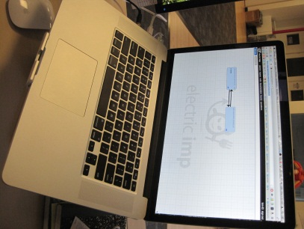

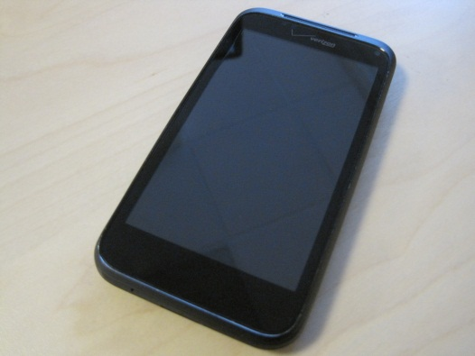
Flexible

Slide 5

Today’s Plan

Slide 6
What do we need to do?
Connect a potentiometer as an input device
Connect an LED as an output device
Copy in some imp firmware

Slide 7
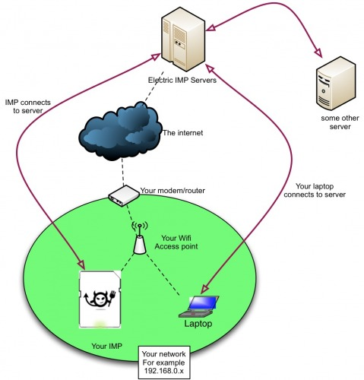
How does the imp work?

Slide 8
How does the imp work?
I’m in device 0C2859A!
Device 0C2859A
imp service
Here’s the firmware for that device!

Slide 9
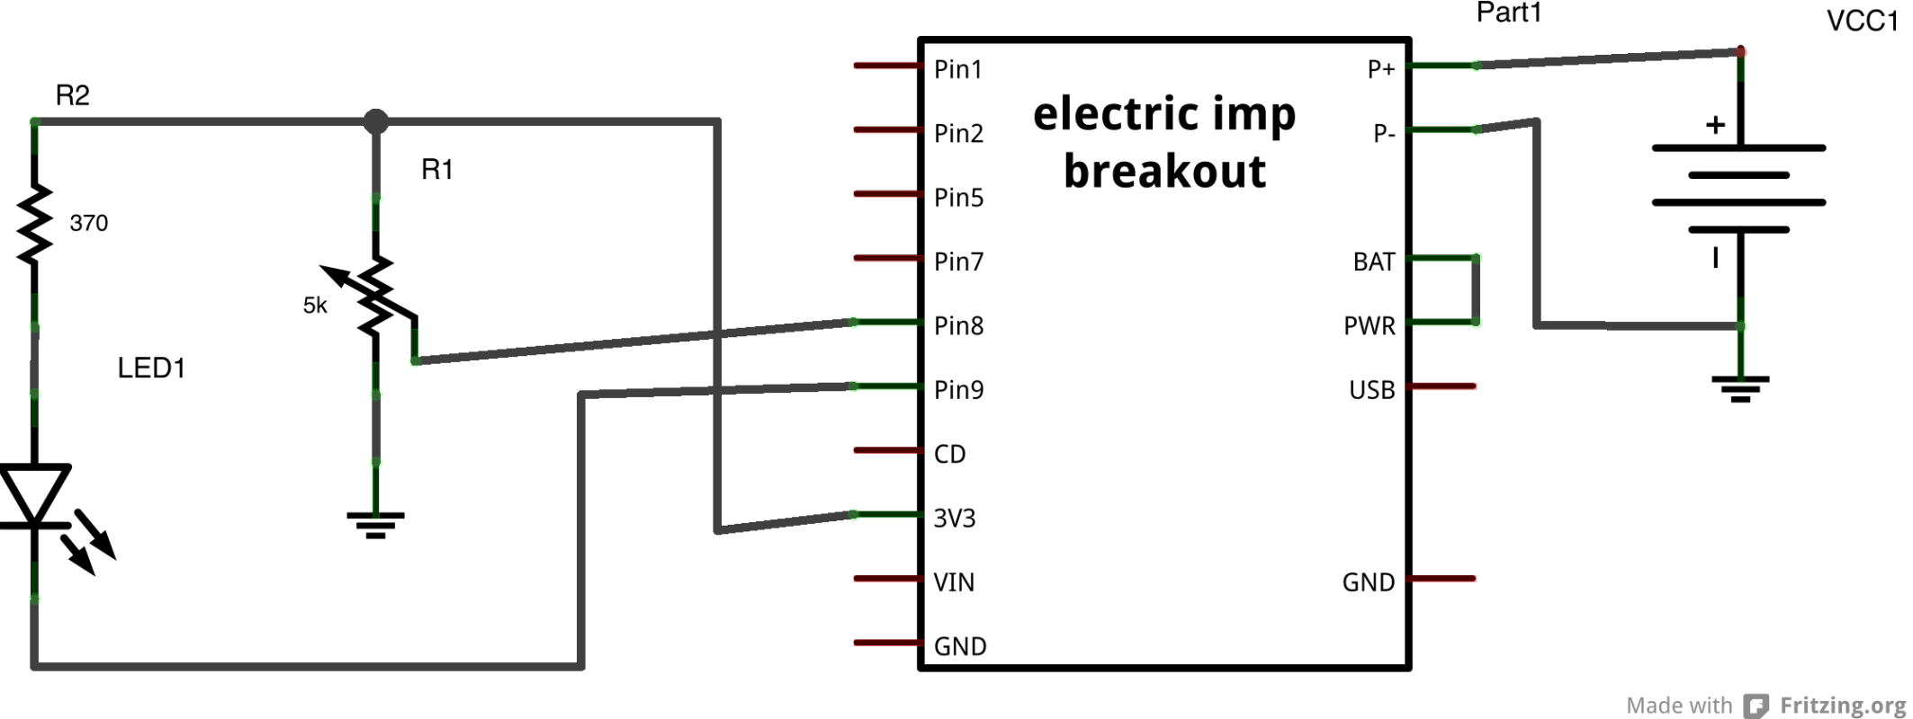
Today’s Schematic

Slide 10
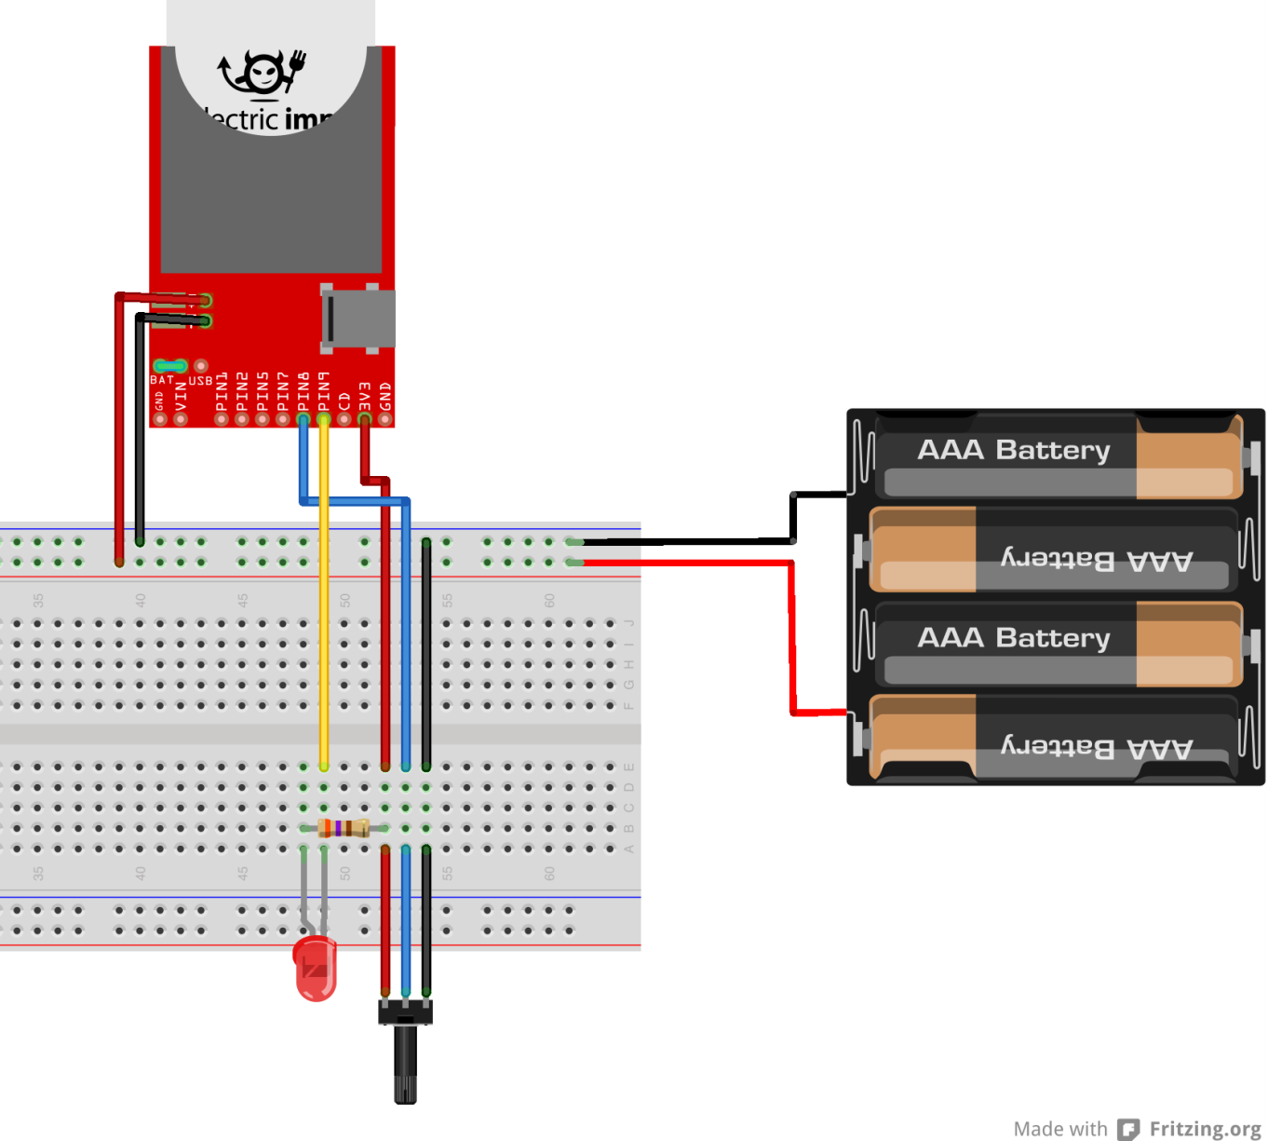
Breadboard Diagram

Slide 11

Step 1: Potentiometer
3.3V
Voltage at imp pin 8 varies between 0V and 3.3V depending on potentiometer position
We read the voltage on pin 8 with an analog-to-digital converter (ADC)
It’s a 16-bit ADC, so values range from [0,65535]
We do a little math and send out a number from 0 to 1
imp pin 8

Slide 12
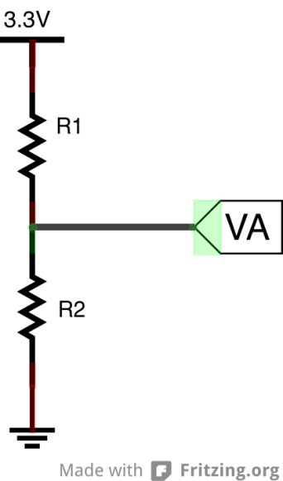
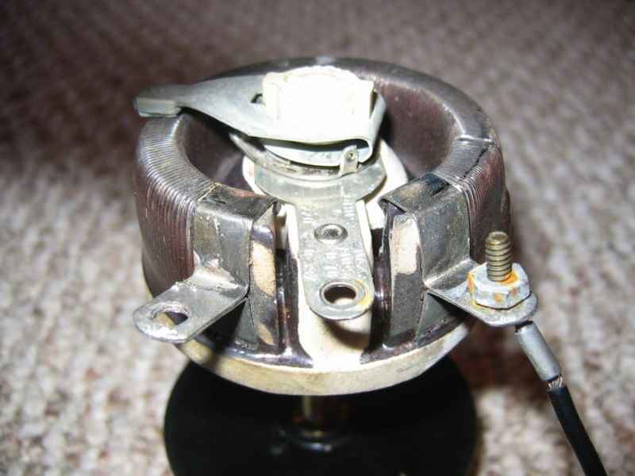
What’s this do?
Potentiometer = a resistive divider with a variable ratio

Slide 13
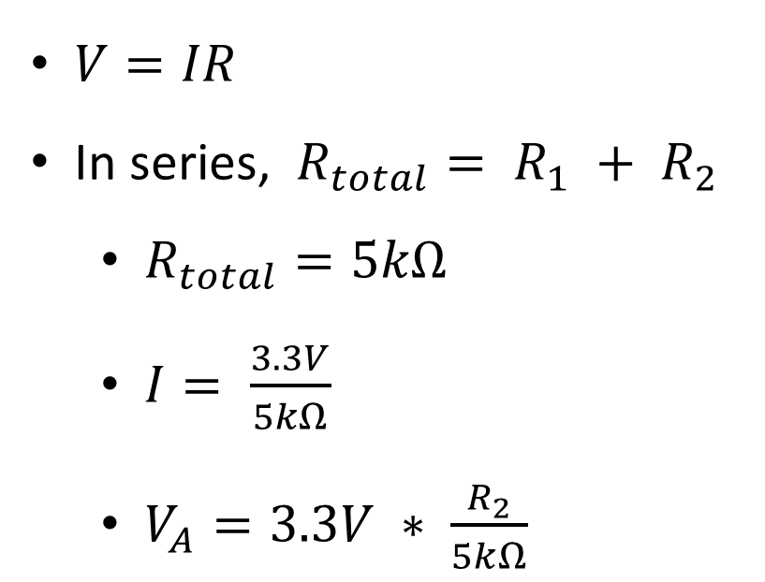
What’s this do?
$V=IR$
In series, $R_{total}= R_{1} + R_{2}$
$R_{total}=5kΩ$
$I= \frac{3.3V}{5kΩ}$
$V_{A}=3.3V ∗ \frac{R_{2}}{5kΩ}$
I

Slide 14
Step 2: LED
3.3V
An LED is just like a normal diode
It only conducts current in one direction, and only above a certain internal voltage
It happens to give off light in the process!
Amount of light varies with current through the diode
Too much current -> POP!
GND

Slide 15
What’s this do?
3.3V
We use an open drain output on the imp to sink current from the LED
The imp can source or sink up to 4 mA per pin in digital output mode
GND

Slide 16
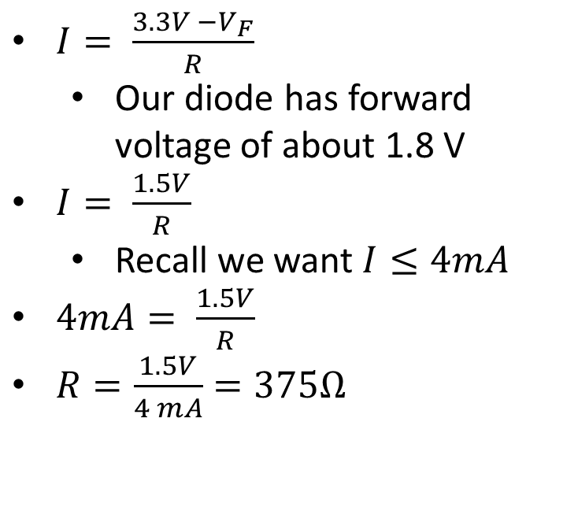
What’s this do?
3.3V
$I= \frac{3.3V −V_{F}}{R}$
Our diode has forward voltage of about 1.8 V
$I= \frac{1.5V}{R}$
Recall we want $I≤4mA$
$4mA= \frac{1.5V}{R}$
$R=\frac{1.5V}{4 mA}=375Ω$
GND

Slide 17
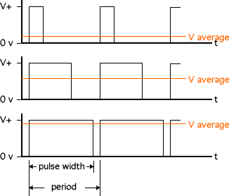
How do we control brightness?
We actually send a pulse width modulated signal to the LED output pin, turning the LED on and off many times a second for varying lengths of time
Your persistence of vision actually does some averaging!

Slide 18
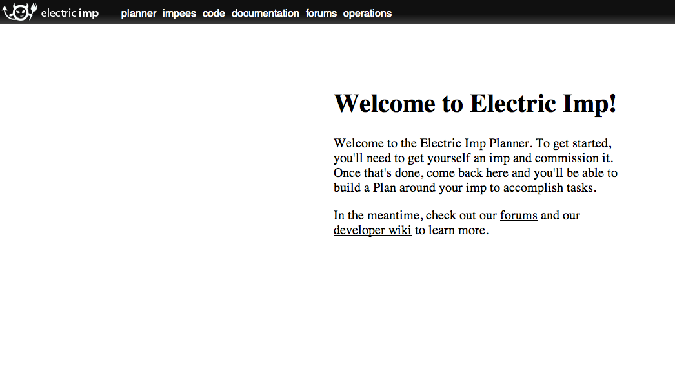
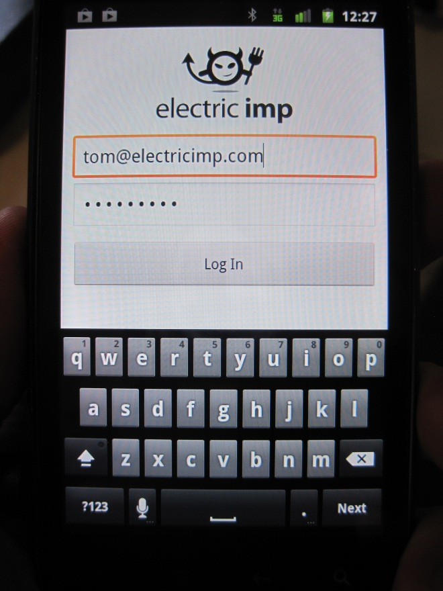
Step 3: code
Head to plan.electricimp.com, register if you haven’t, and log in
Download the electric imp app from your app store of choice and log in

Slide 19
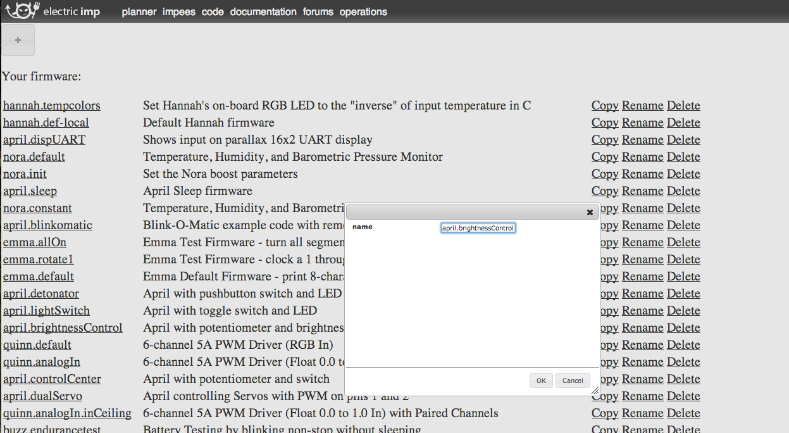
Get the code
Open the code tab in the planner and click the “+” button to add a new imp firmware
Name your new firmware and click ok. You’ll go to the imp IDE.

Slide 20
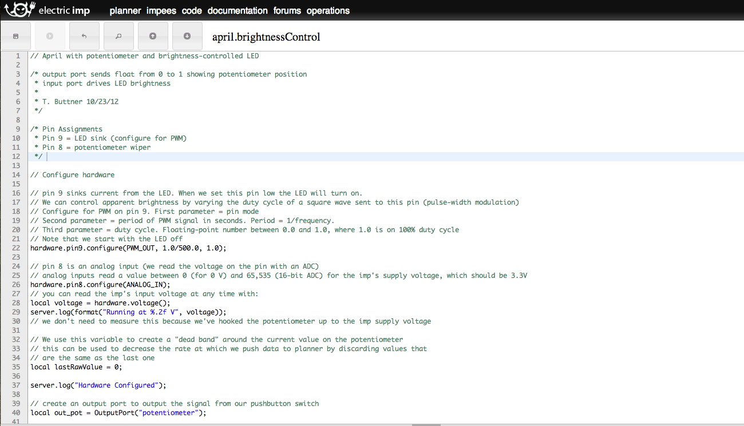
Add the code
Open a new browser tab and go to https://github.com/tombrew/ei-fw-tom/blob/master/april-brightnessControl.nut
Copy the new code into the IDE and click the save button, then go back to the plan view

Slide 21
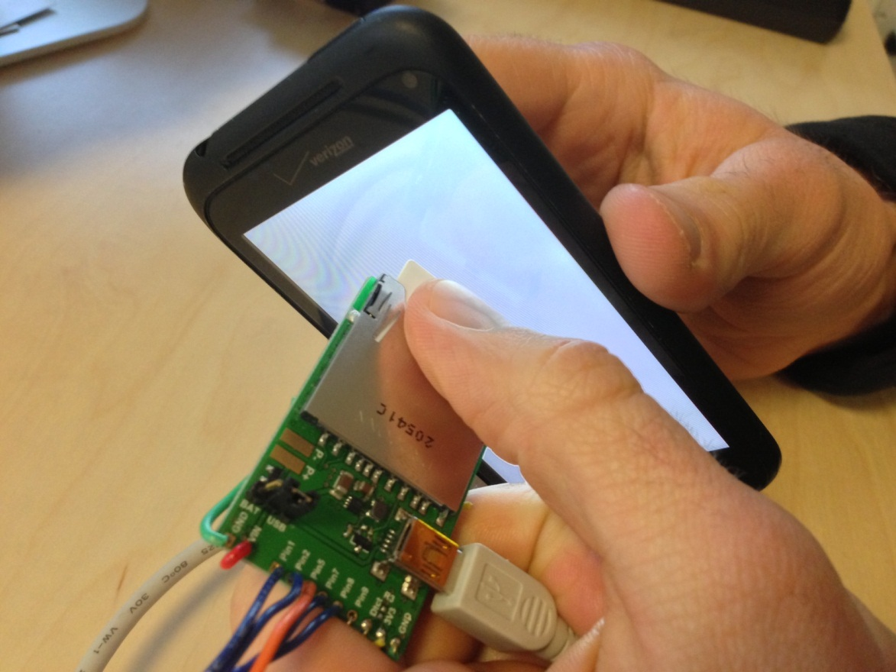
BlinkUp
This is how your imp knows what network to join, how to join it, and whose plan to appear in
Your phone sends the SSID and WiFi password to the imp with a series of “blinks”

Slide 22
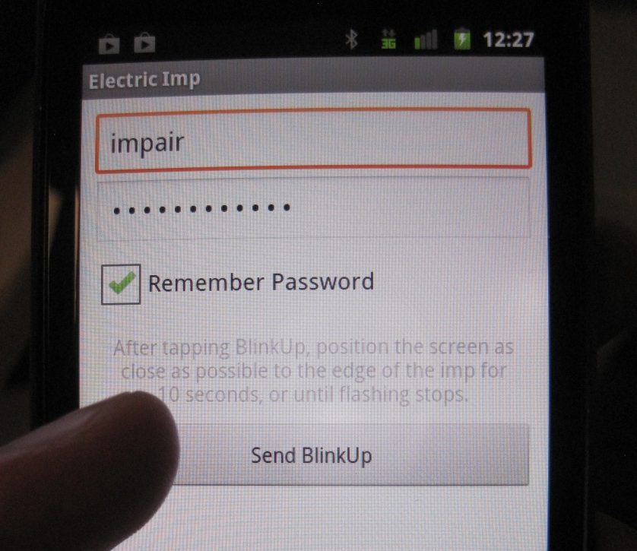
BlinkUp
Log into the electric imp app on your smartphone
Add the local network SSID and password to the app
Hold your phone up to the imp and press “send blinkup”
If you’re blinking up in a bright place, covering the imp with your thumb reduces ambient light and will help the imp detect pulses

Slide 23
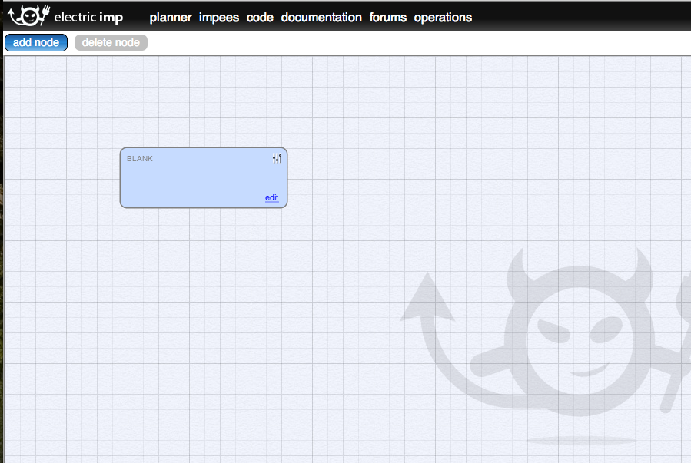
An imp appears!
The blinked-up imp will appear in your plan
If you haven’t blinked up an imp in this board before, it will say “BLANK”

Slide 24
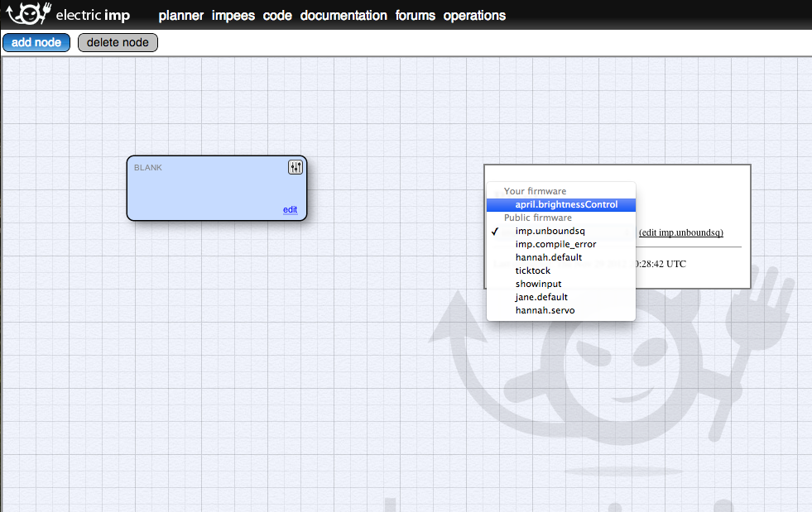
Change firmware
Click the settings button in the top right corner of your new impee and select your new firmware from the dropdown menu

Slide 25
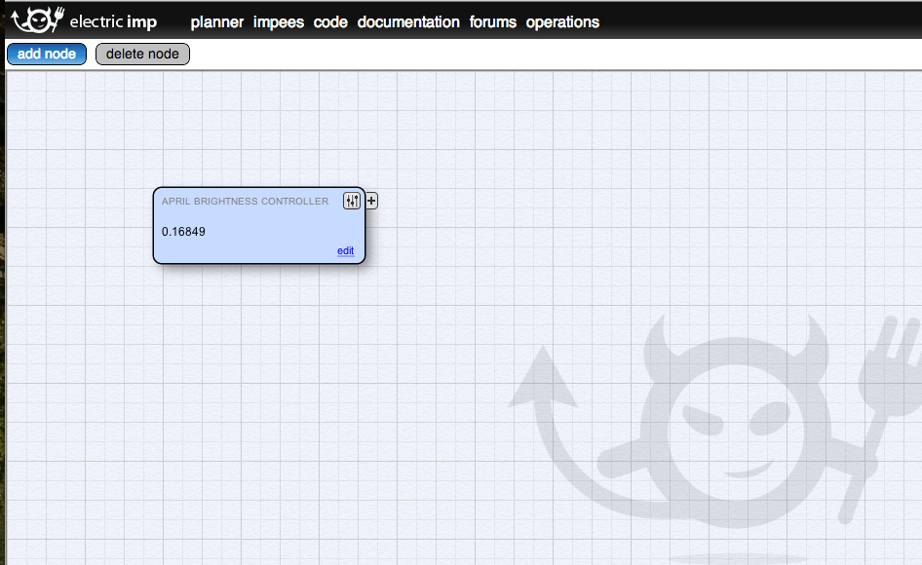
Test
After a second or two, the imp should be running the new firmware
You should see a number inside the impee node in the planner showing the position of your potentiometer

Slide 26
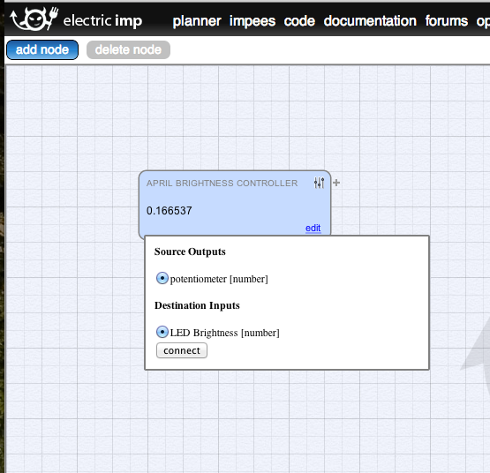
Test
You can connect your own potentiometer to your own LED to test the LED
Click the “+” next to the settings button and drag the arrow back to your new impee
Select the input port in the popup and click “connect”

Slide 27
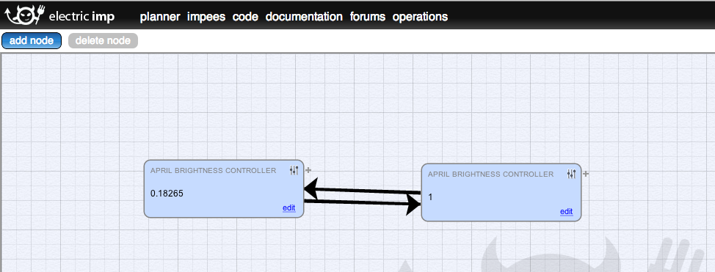
Connect imps
Blink up a partner’s imp – now both are in one plan
Draw a connection from one to the other – now one controls the other’s LED!
Draw another connection in the other direction – now they control each other!

Slide 28
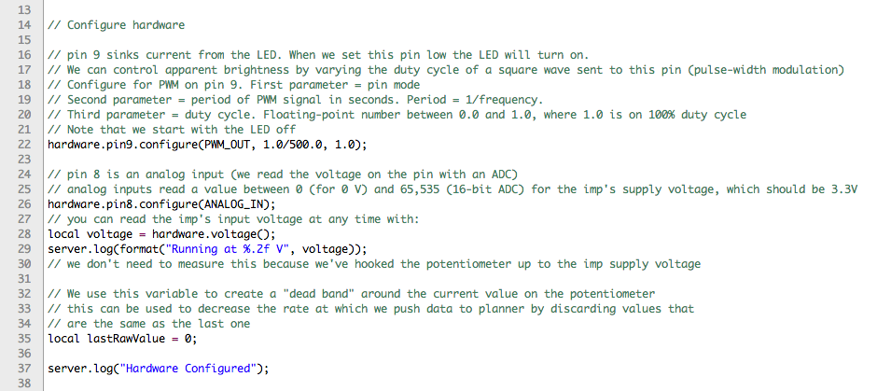
Imp FW: hardware config
hardware.configure tells a pin what it is
We can declare local variables at global scope to make global variables
server.log sends messages to your log – below the code in the IDE

Slide 29
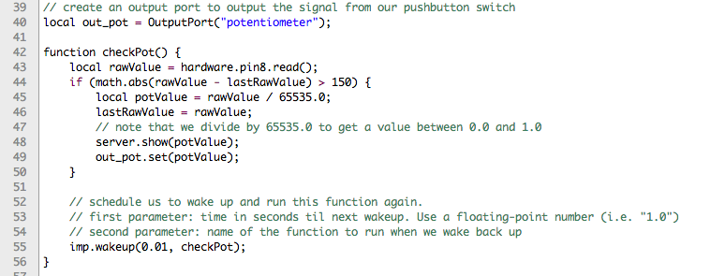
Imp FW: Output Ports, functions
Call OutputPort() to create a new output port object with a name – now you can pick this output port in the planner with the “+” button
Use yourOutputPort.set() to update the value in your new output port
You can declare and call functions, just as you’d expect

Slide 30
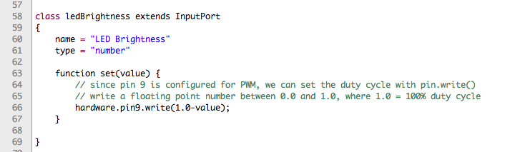
Imp FW: Input Ports, Classes
Extend the InputPort class to conveniently create a new input port – this can now accept new connections in the planner
Implement a set method in your new input class to tell your imp what to do when this input value is changed
The name and type members are shown in the planner when you select the input port to connect to

Slide 31
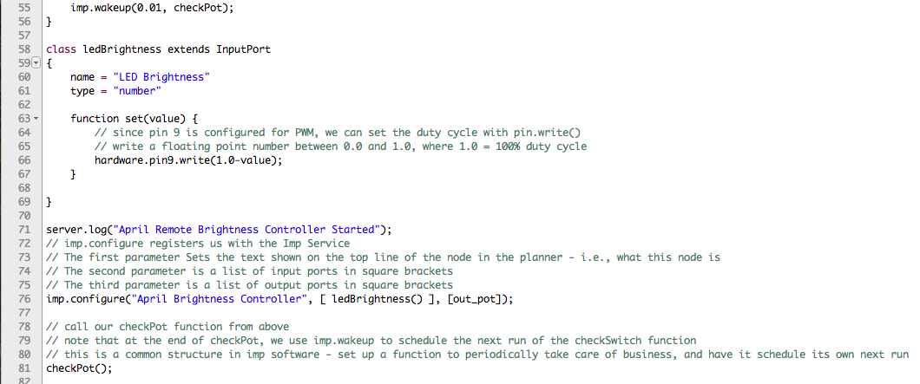
Imp FW: wakeup
One of the most useful imp firmware design techniques – to do an action every n seconds, have the function that does that action schedule itself to run again every time it runs
Use imp.wakeup() to schedule this wakeup and callback
Check out http://devwiki.electricimp.com/doku.php for the imp API reference

Slide 32
Imp FW: configure
imp.configure() registers this impee with the imp service
This function takes three parameters:
A string to display in the planner to show what the node is (“April Brightness Controller”)
An array of input ports
An array of output ports

